Slide 1
Multiarea OSPF
Scaling Networks- CCNA-3 - Chapter 6
CCNA Routing & Switching Study Guide- Chapter 20
Taken from Slides provided by Cisco Networking Academy
Notes:
Cisco Networking Academy program
Scaling Networks
Chapter 6

Slide 2
Objectives
Introduction
Multiarea OSPF
Configuring Multiarea OSPF
Summary
Notes:
Chapter 6

Slide 3
Multiarea OSPF Operation
Notes:
6.1 Multiarea OSPF Operation

Slide 4
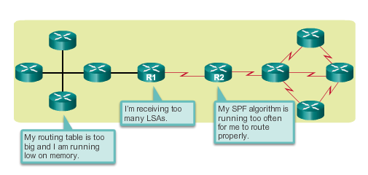
Why Multiarea OSPF? Single-Area OSPF
Single-area OSPF is useful in smaller networks. If an area becomes too big, the following issues must be addressed:
Large routing table (no summarization by default)
Large link-state database (LSDB)
Frequent SPF algorithm calculations
Notes:
6.1.1.1 Single-Area OSPF

Slide 5
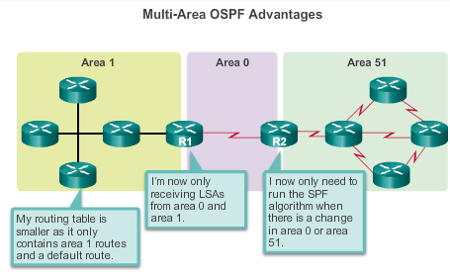
Why Multiarea OSPF? Multiarea OSPF
Multiarea OSPF requires a hierarchical network design and the main area is called the backbone area, or area 0, and all other areas must connect to the backbone area.
Notes:
6.1.1.2 Multiarea OSPF

Slide 6
Why Multiarea OSPF? OSPF Two-Layer Area Hierarchy
Multiarea OSPF is implemented in a two-layer area hierarchy:
Backbone (transit) area
Area whose primary function is the fast and efficient movement of IP packets.
Interconnects with other OSPF area types.
Called OSPF area 0, to which all other areas directly connect.
Regular (nonbackbone) area
Connects users and resources.
A regular area does not allow traffic from another area to use its links to reach other areas.
Notes:
6.1.1.3 OSPF Two-Layer Area Hierarchy

Slide 7
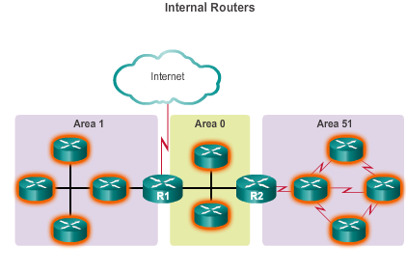
Why Multiarea OSPF? Types of OSPF Routers
Notes:
6.1.1.4 Types of OSPF Routers

Slide 8
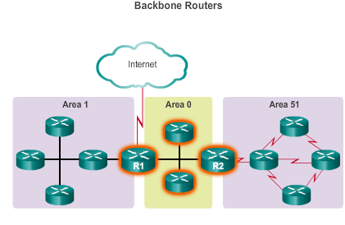
Why Multiarea OSPF? Types of OSPF Routers (cont.)
Notes:
6.1.1.4 Types of OSPF Routers

Slide 9
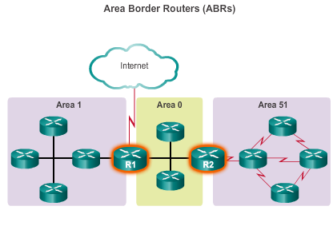
Why Multiarea OSPF? Types of OSPF Routers (cont.)
Notes:
6.1.1.4 Types of OSPF Routers

Slide 10
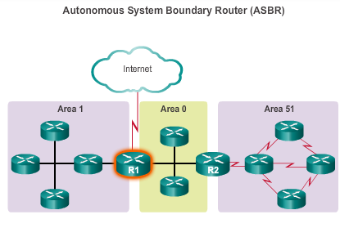
Why Multiarea OSPF? Types of OSPF Routers (cont.)
Notes:
6.1.1.4 Types of OSPF Routers

Slide 11
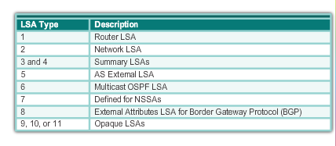
Multiarea OSPF LSA Operation OSPF LSA Types
Most common and covered in this course – 1 thru 5
Notes:
6.1.2.1 OSPF LSA Types

Slide 12
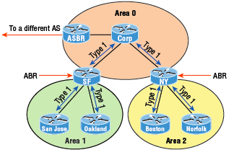
Multiarea OSPF LSA Operation OSPF LSA Type 1
Route Link Advertisement(RLA)
Sent by every routers to other routers in it’s area
If connected to multiple areas, separate LSA Type 1 for each of the areas
Contains router ID,interfaces, IP info, current interface state.
Notes:
6.1.2.2 OSPF LSA Type 1

Slide 13
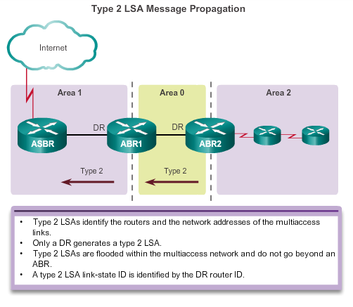
Multiarea OSPF LSA Operation OSPF LSA Type 2
Network Link Advertisement(NLA)
Notes:
6.1.2.3 OSPF LSA Type 2

Slide 14
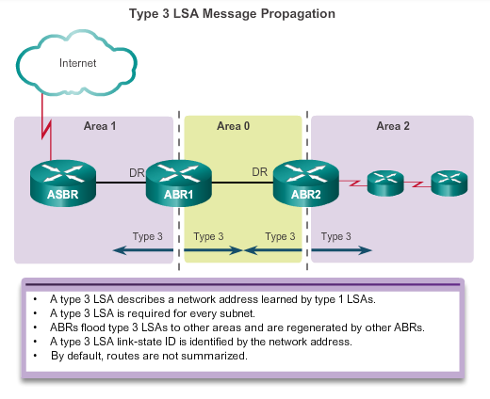
Multiarea OSPF LSA Operation OSPF LSA Type 3
Summary Link Advertisement(SLA)
Notes:
6.1.2.4 OSPF LSA Type 3

Slide 15
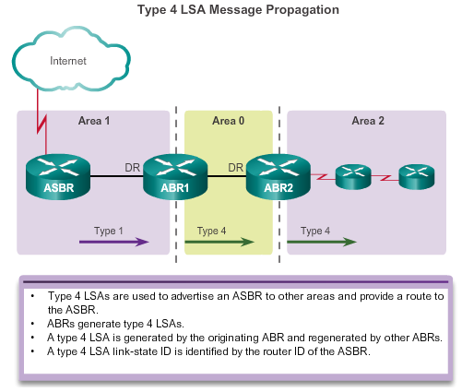
Multiarea OSPF LSA Operation OSPF LSA Type 4
Notes:
6.1.2.5 OSPF LSA Type 4

Slide 16
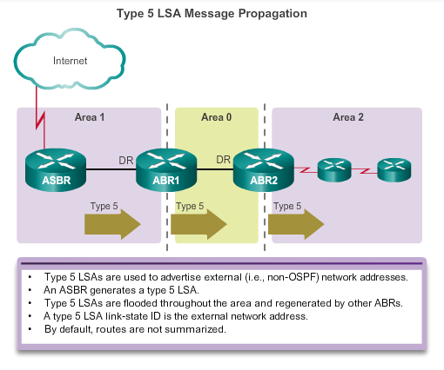
Multiarea OSPF LSA Operation OSPF LSA Type 5
External Link Advertisement(ELA)
Notes:
6.1.2.6 OSPF LSA Type 5

Slide 17
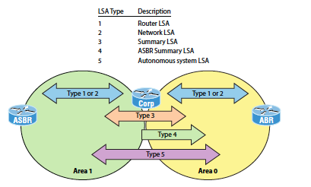
Basic LSA Types

Slide 18
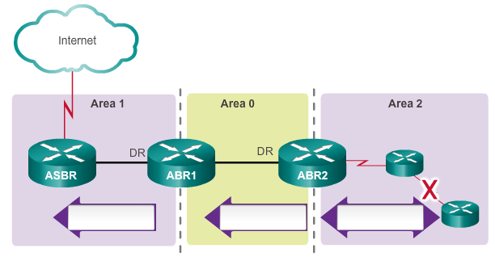
Activity
LSA Type 3
LSA Type 3
LSA Type 1

Slide 19
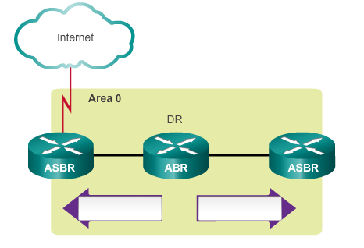
Activity
LSA Type 2
LSA Type 2

Slide 20
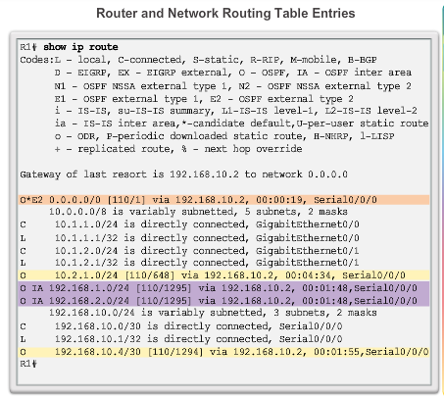
OSPF Routing Tables and Route Types OSPF Routing Table Entries
O – Router (type 1) and network (type 2) LSAs describe the details within an area (the route is intra-area).
O IA – Summary LSAs appear in the routing table as IA (interarea routes)
O E1 or OE 2 – External LSAs external type 1 (E1) or external type 2 (E2) routes
Notes:
6.1.3.1 OSPF Routing Table Entries

Slide 21
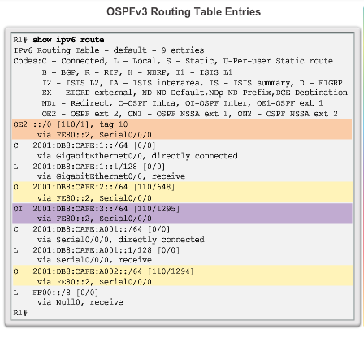
OSPF Routing Tables and Route Types OSPF Routing Table Entries (cont.)
O – Router (type 1) and network (type 2) LSAs describe the details within an area (the route is intra-area)
O IA – Summary LSAs appear in the routing table as IA (interarea routes)
O E1 or OE 2 – External LSAs external type 1 (E1) or external type 2 (E2) routes
Notes:
6.1.3.1 OSPF Routing Table Entries

Slide 22
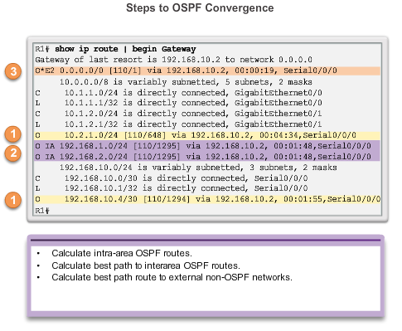
OSPF Routing Tables and Route Types OSPF Route Calculation
All routers calculate the best paths to destinations within their area (intra-area) and add these entries to the routing table.
All routers calculate the best paths to the other areas within the internetwork (interarea) or type 3 and type 4 LSAs.
All routers calculate the best paths to the external autonomous system (type 5) destinations. These are noted with either an O E1 or an O E2 route designator.
Notes:
6.1.3.2 OSPF Route Calculation

Slide 23
OSPF STATES
Notes:
6.2 Configuring Multiarea OSPF

Slide 24
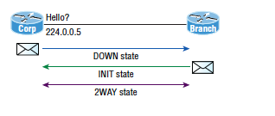
OSPF Neighbor States- Part 1
Exchange information using Hello Protocol via multicast address 224.0.0.5

Slide 25
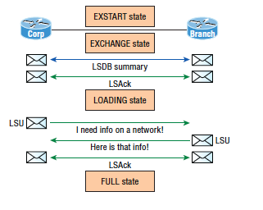
OSPF Neighbor States- Part 2

Slide 26
Configuring Multiarea OSPF
Notes:
6.2 Configuring Multiarea OSPF

Slide 27
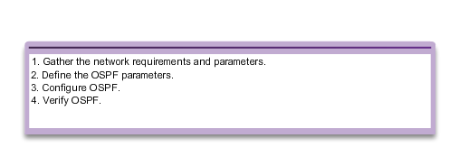
Configuring Multiarea OSPF Implementing Multiarea OSPF
Implementation Plan Steps
Notes:
6.2.1.1 Implementing Multiarea OSPF

Slide 28
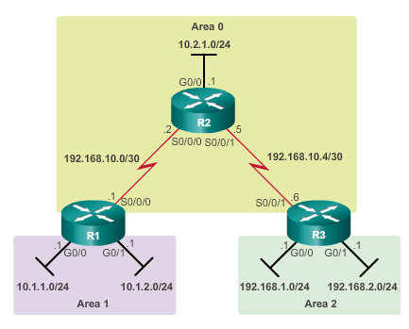
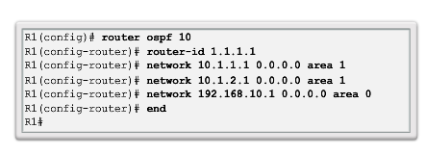
Configuring Multiarea OSPF Configuring Multiarea OSPF
Notes:
6.2.1.2 Configuring Multiarea OSPF

Slide 29
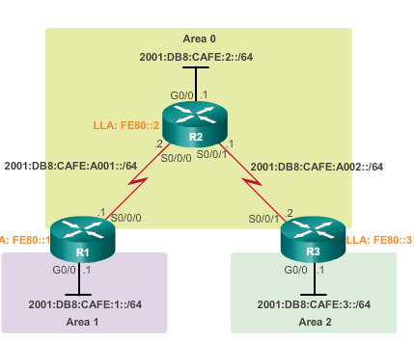
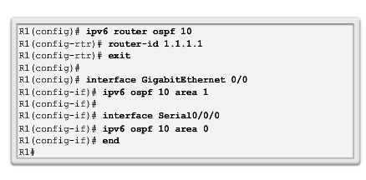
Configuring Multiarea OSPF Configuring Multiarea OSPFv3
Notes:
6.2.1.3 Configuring Multiarea OSPFv3

Slide 30
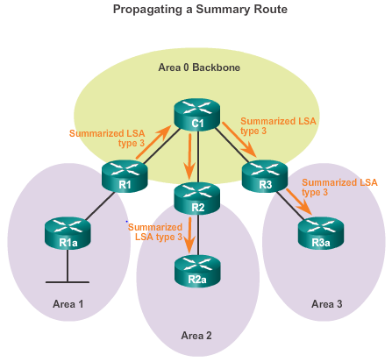
OSPF Route Summarization OSPF Route Summarization
R1 forwards a summary LSA to the core router C1.
C1, in turn, forwards the summary LSA to R2 and R3.
R2 and R3 then forward it to their respective internal routers.
Notes:
6.2.2.1 OSPF Route Summarization

Slide 31
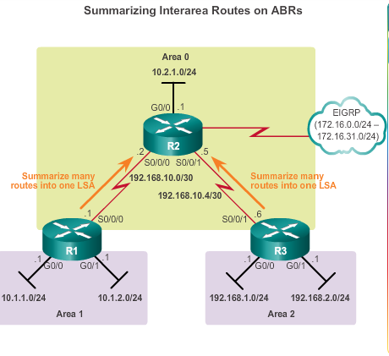
OSPF Route Summarization Interarea and External Route Summarization
Occurs on ABRs and applies to routes from within each area
Notes:
6.2.2.2 Interarea and External Route Summarization

Slide 32
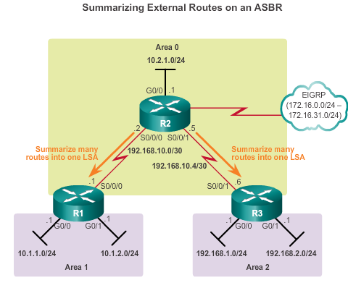
OSPF Route Summarization Interarea and External Route Summarization (cont.)
Specific to external routes that are injected into OSPF via route redistribution; ASBRs summarize external routes
Notes:
6.2.2.2 Interarea and External Route Summarization

Slide 33
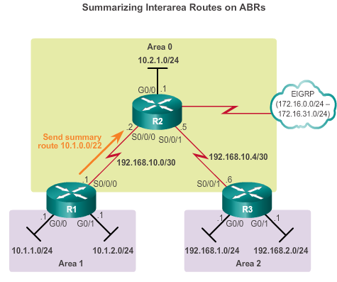
OSPF Route Summarization Interarea Route Summarization
Notes:
6.2.2.3 Interarea Route Summarization

Slide 34
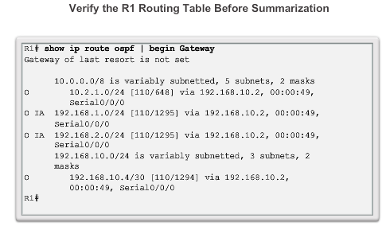
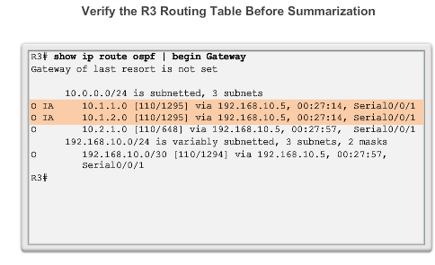
OSPF Route Summarization Interarea Route Summarization (cont.)
Notes:
6.2.2.3 Interarea Route Summarization

Slide 35
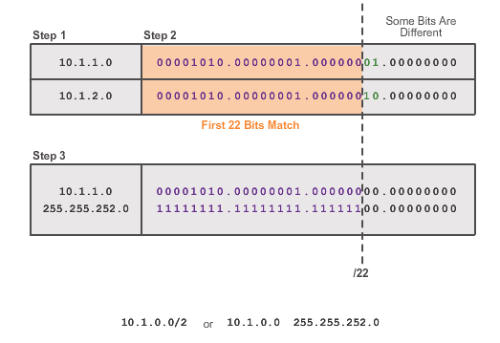
OSPF Route Summarization Calculating the Summary Route
2
Notes:
6.2.2.4 Calculating the Summary Route

Slide 36
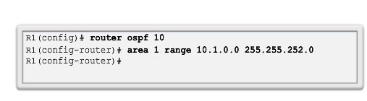
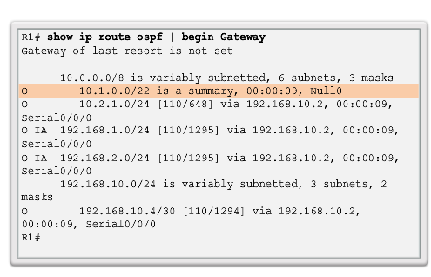
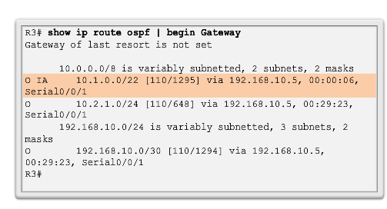
OSPF Route Summarization Configuring Interarea Route Summarization
R1
R3
Notes:
6.2.2.5 Configuring Interarea Route Summarization

Slide 37
Verifying Multiarea OSPF Verifying Multiarea OSPF
The same verification commands are used to verify single-area OSPF and can be used to verify multiarea OSPF:
show ip ospf neighbor
show ip ospf
show ip ospf interface
Commands specific to multiarea information include:
show ip protocols
show ip ospf interface brief
show ip route ospf
show ip ospf database
Note: For OSPFv3, substitute ip with ipv6.
Notes:
6.2.3.1 Verifying Multiarea OSPF

Slide 38
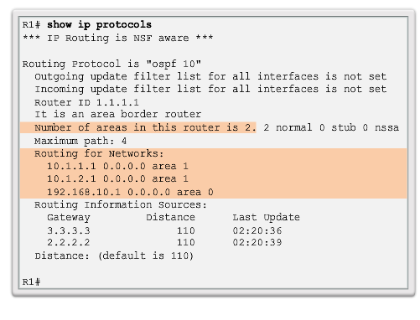
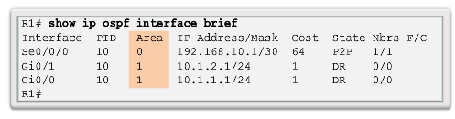
Verifying Multiarea OSPF Verifying General Multiarea OSPF Settings
Notes:
6.2.3.2 Verify General Multiarea OSPF Settings

Slide 39
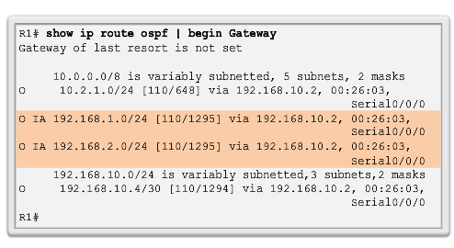
Verifying Multiarea OSPF Verify the OSPF Routes
Notes:
6.2.3.3 Verify the OSPF Routes

Slide 40
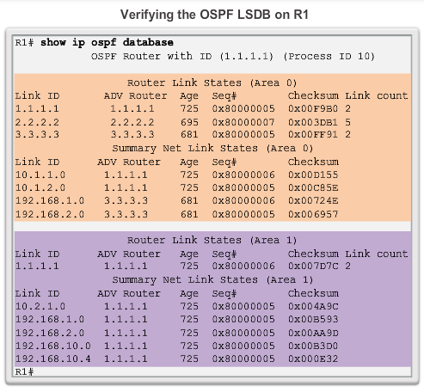
Verifying Multiarea OSPF Verifying the Multiarea OSPF LSDB
Notes:
6.2.3.4 Verify the Multiarea OSPF LSDB

Slide 41
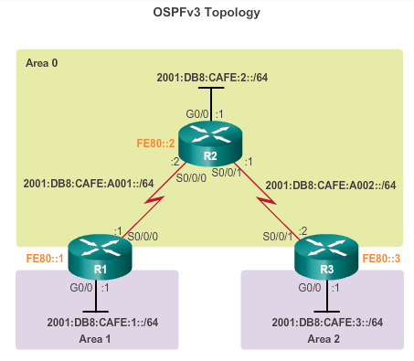
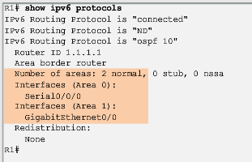
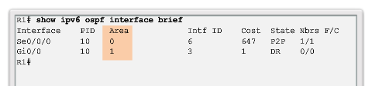
Verifying Multiarea OSPF Verifying Multiarea OSPFv3
Notes:
6.2.3.5 Verifying Multiarea OSPFv3

Slide 42
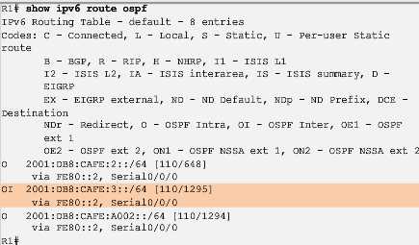
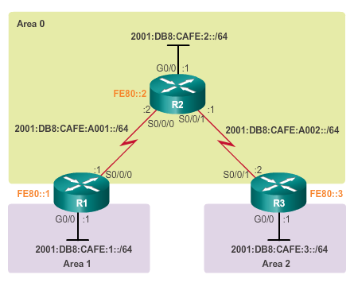
Verifying Multiarea OSPF Verifying Multiarea OSPFv3 (cont.)
Notes:
6.2.3.5 Verifying Multiarea OSPFv3

Slide 43
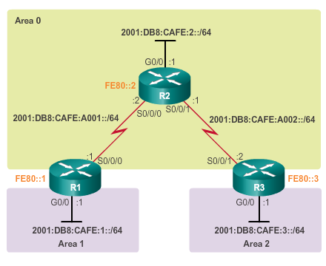
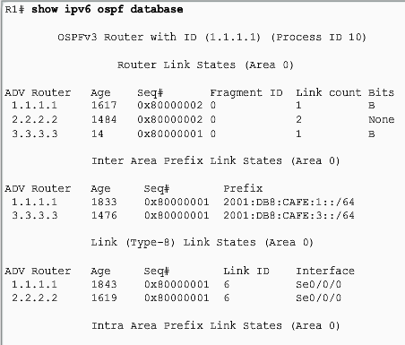
Verifying Multiarea OSPF Verifying Multiarea OSPFv3 (cont.)
Notes:
6.2.3.5 Verifying Multiarea OSPFv3

Slide 44
Chapter 6: Summary Multiarea OSPF Summary
Better choice for larger networks than single-area.
Solves the issues of large routing table, large LSDB, and frequent SPF algorithm calculations.
Main area is called the backbone area, or area 0.
Recalculating the database is kept within an area.
Four different types of OSPF routers:
Internal router
Backbone router
ABR
ASBR
A router simply becomes an ABR when it has two network statements in different areas.
Notes:
Chapter 6 Summary

Slide 45
Chapter 6: Summary Multiarea OSPF Summary (cont.)
Link-state advertisements (LSAs) are the building blocks of OSPF.
Type 1 LSAs are referred to as the router link entries.
Type 2 LSAs are referred to as the network link entries and are flooded by a DR.
Type 3 LSAs are referred to as the summary link entries and are created and propagated by ABRs.
A type 4 summary LSA is generated by an ABR only when an ASBR exists within an area.
Type 5 external LSAs describe routes to networks outside the OSPF autonomous system, originated by the ASBR and are flooded to the entire autonomous system.
SPF tree is used to determine the best paths.
OSPF routes in an IPv4 routing table are identified using the following descriptors: O, O IA, O E1, or O E2.
Notes:
Chapter 6 Summary

Slide 46
Chapter 6: Summary Multiarea OSPF Summary (cont.)
The following example displays a multiarea OSPF configuration:
R1(config)# router ospf 10
R1(config-router)# router-id 1.1.1.1
R1(config-router)# network 10.1.1.1 0.0.0.0 area 1
R1(config-router)# network 10.1.2.1 0.0.0.0 area 1
R1(config-router)# network 192.168.10.1 0.0.0.0 area 0
Does not perform autosummarization, but can be manually configured using the summary-address address mask router configuration mode command
Notes:
Chapter 6 Summary

Slide 47
Chapter 6: Summary Multiarea OSPF Summary (cont.)
The following commands are used to verify OSPF configurations:
show ip ospf neighbor
show ip ospf
show ip ospf interface
show ip protocols
show ip ospf interface brief
show ip route ospf
show ip ospf database
Notes:
Chapter 6 Summary

